Slide 1
Data Management for Data Science
Lecture 19: Unsupervised Learning/Ensemble Learning
Prof. Asoc. Endri Raço

Slide 2
Today
Unsupervised Learning/Clustering
K-Means
Ensembles and Gradient Boosting

Slide 3
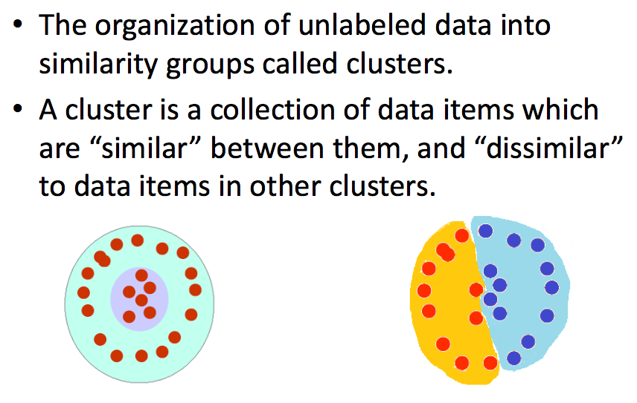
What is clustering?

Slide 4
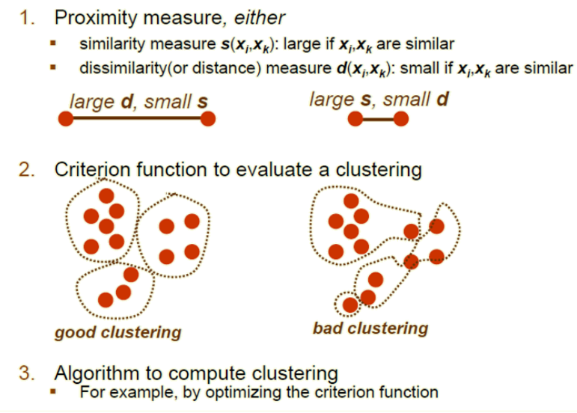
What do we need for clustering?

Slide 5
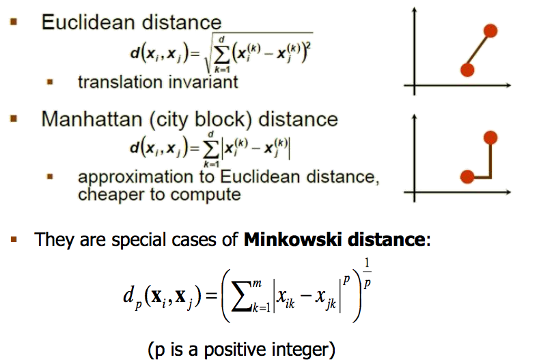
Distance (dissimilarity) measures

Slide 6
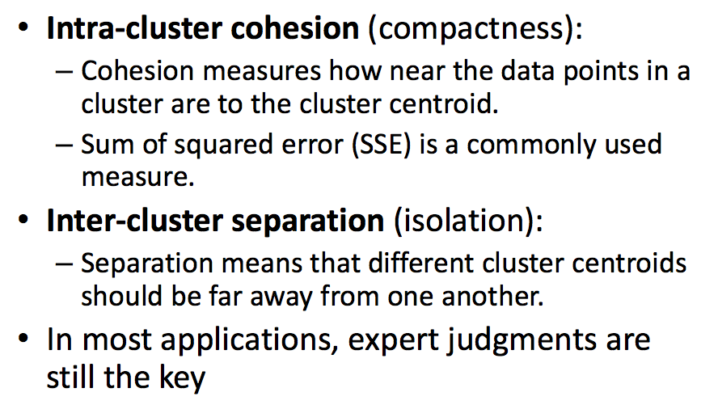
Cluster evaluation (a hard problem)

Slide 7
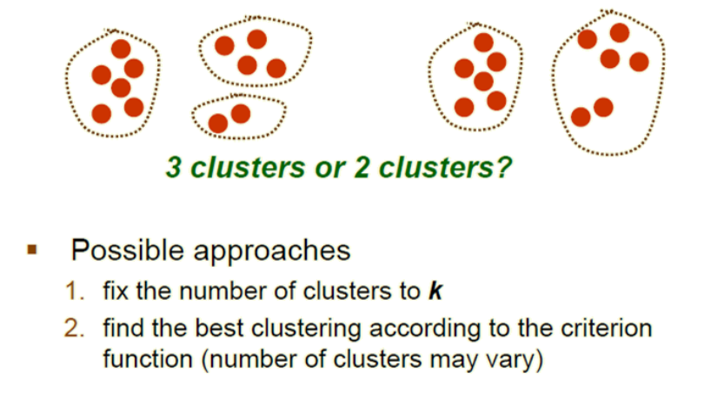
How many clusters?

Slide 8
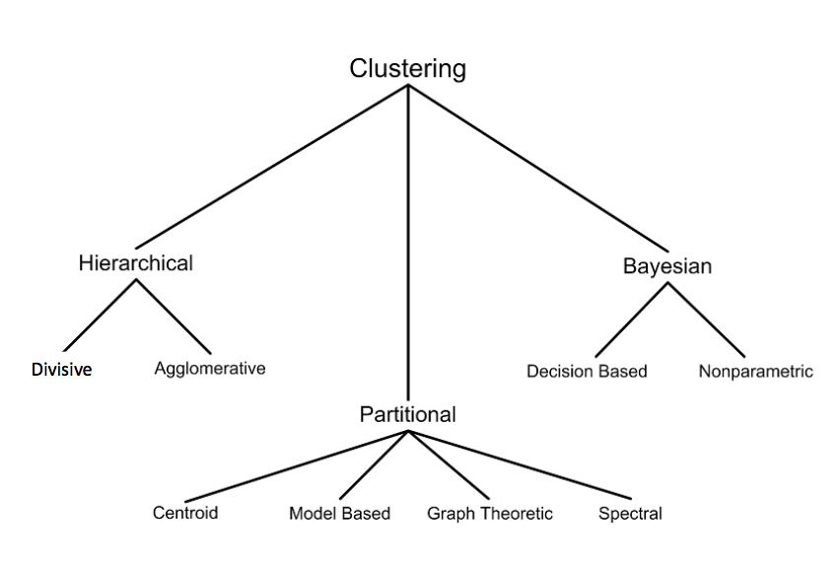
Clustering techniques

Slide 9
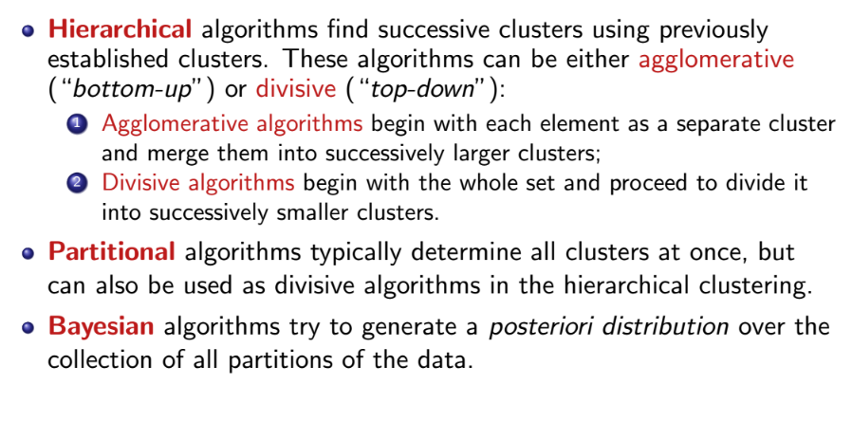
Clustering techniques

Slide 10
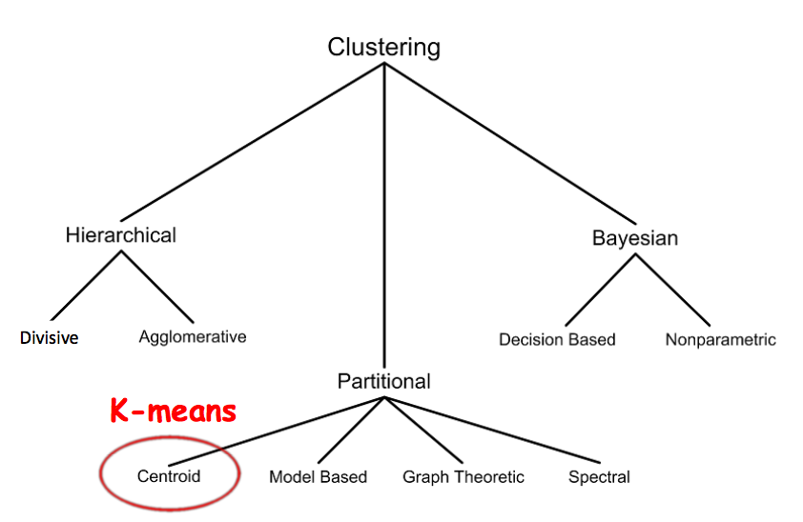
Clustering techniques

Slide 11
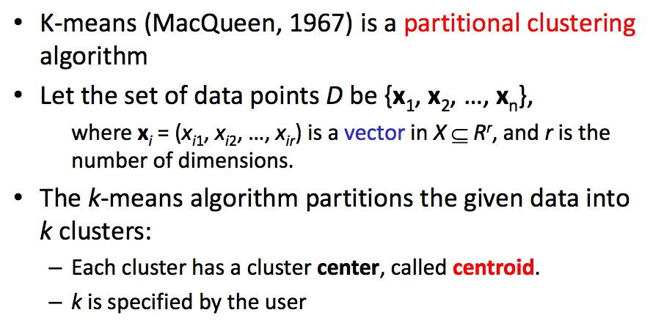
K-means

Slide 12
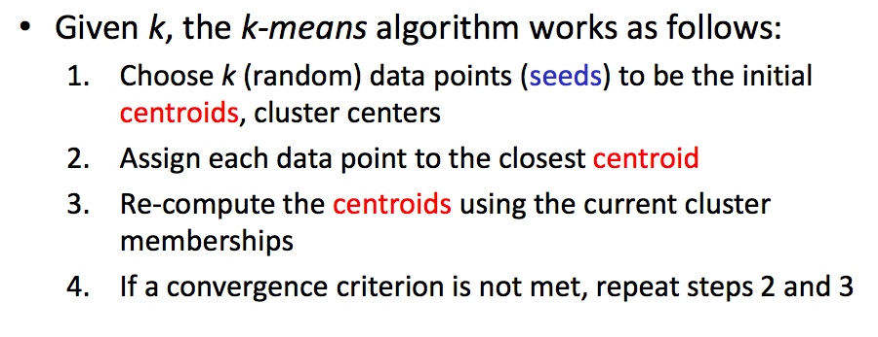
K-means algorithm

Slide 13
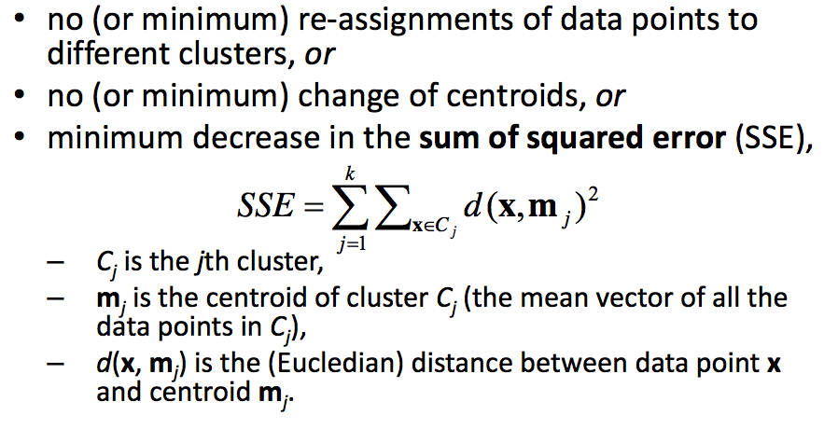
K-means convergence (stopping criterion)

Slide 14
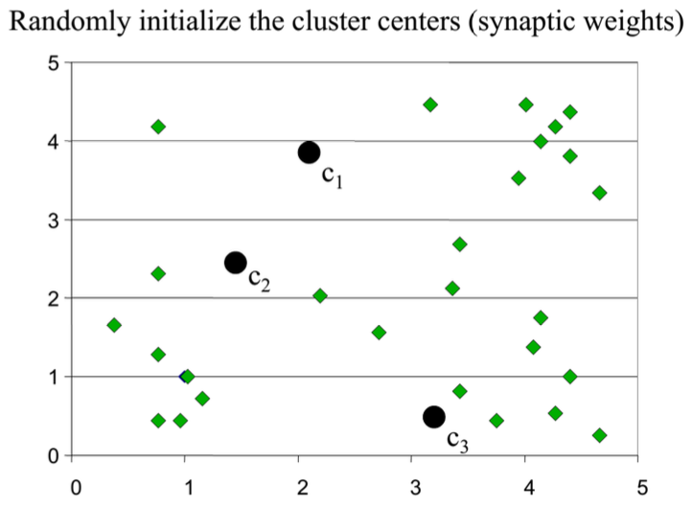
K-means clustering example: step 1

Slide 15
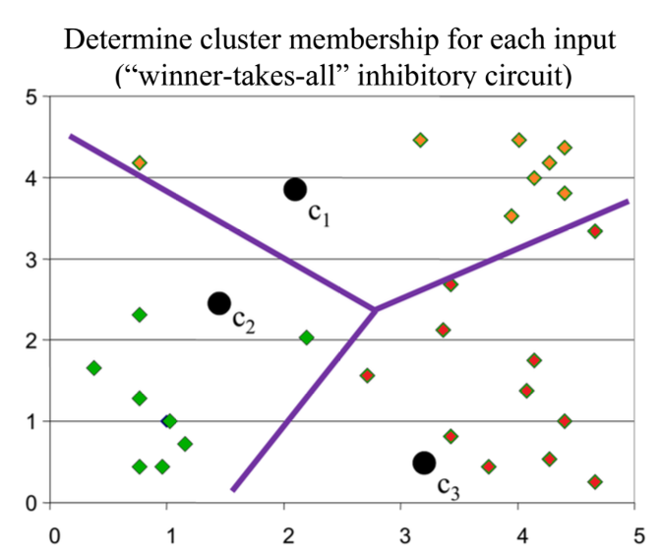
K-means clustering example: step 2

Slide 16
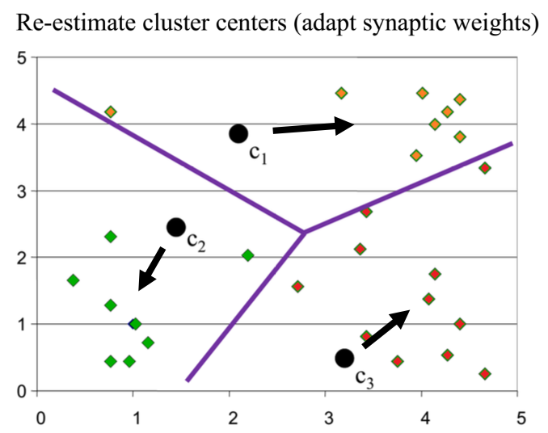
K-means clustering example: step 3

Slide 17
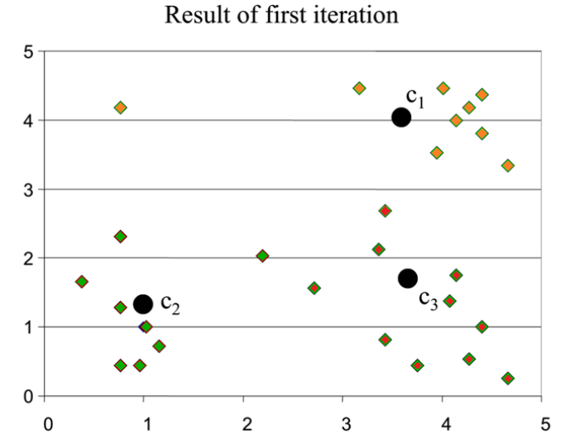
K-means clustering example

Slide 18
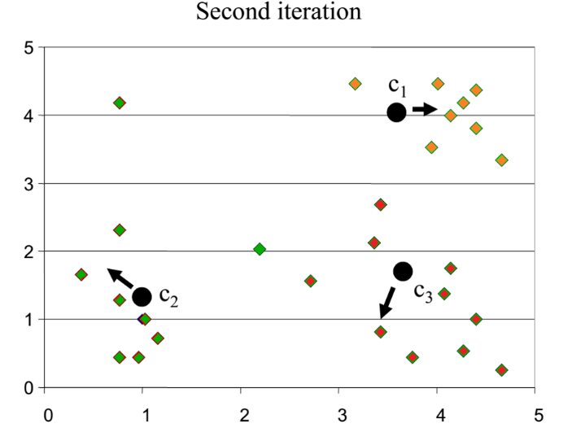
K-means clustering example

Slide 19
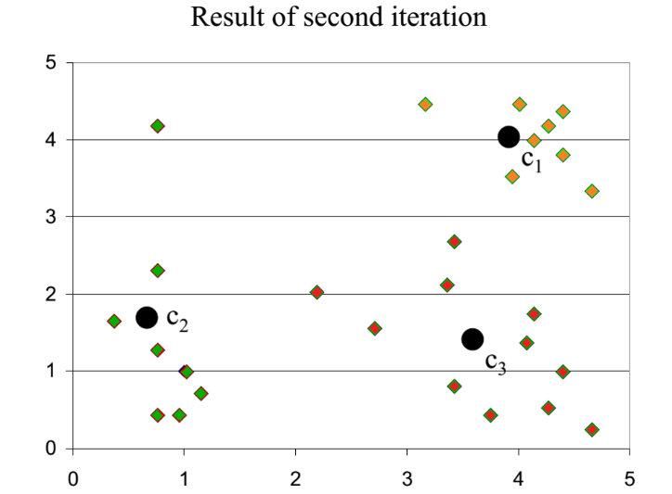
K-means clustering example

Slide 20
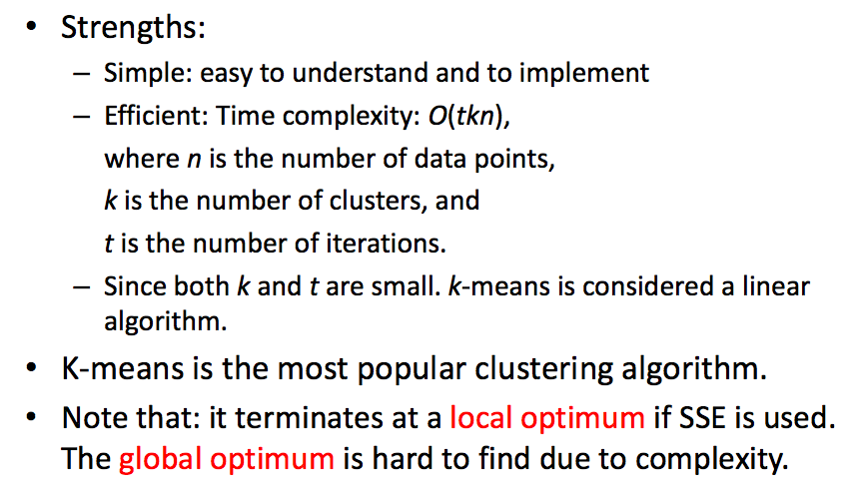
Why use K-means?

Slide 21
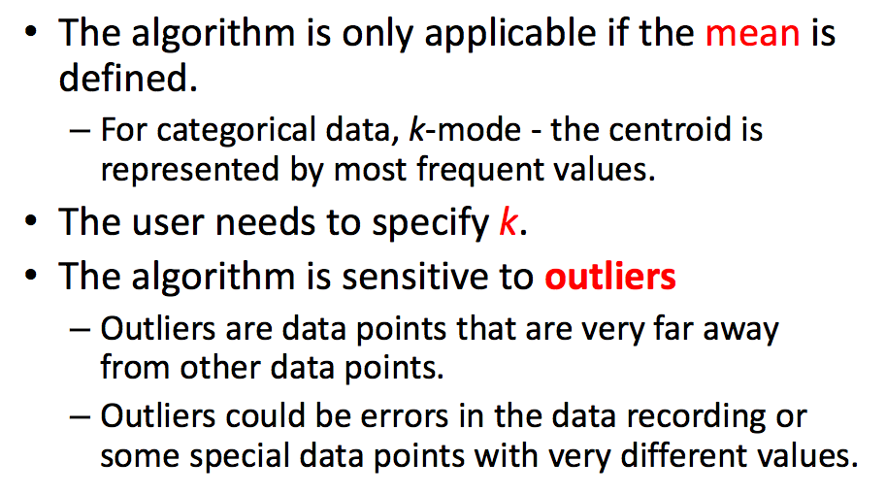
Weaknesses of K-means

Slide 22
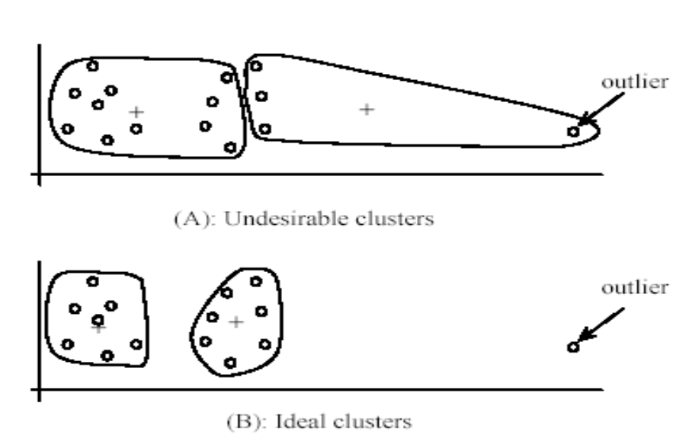
Outliers

Slide 23
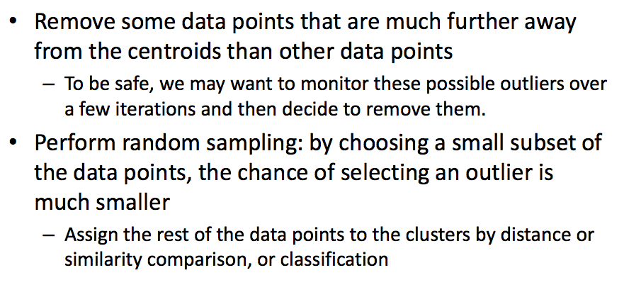
Dealing with outliers

Slide 24
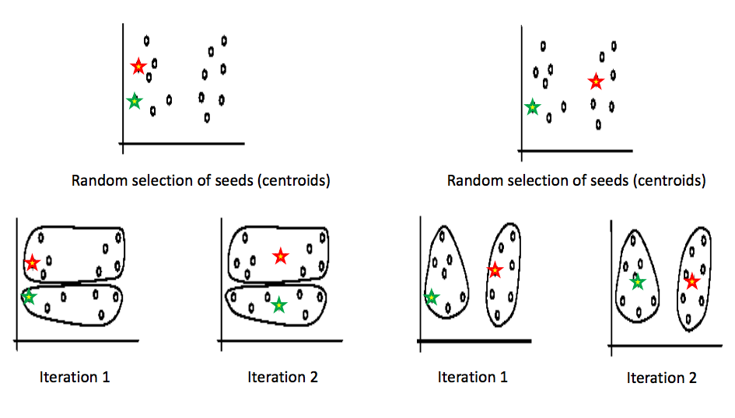
Sensitivity to initial seeds

Slide 25
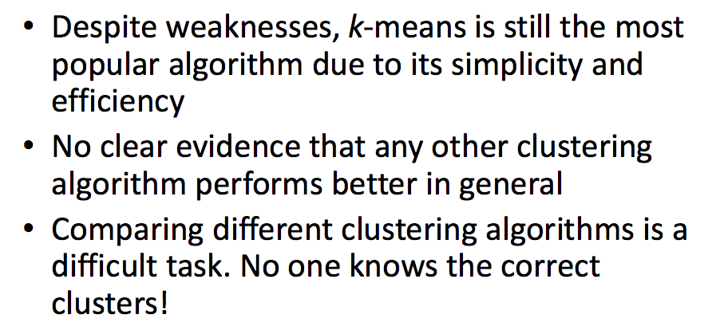
K-means summary

Slide 26
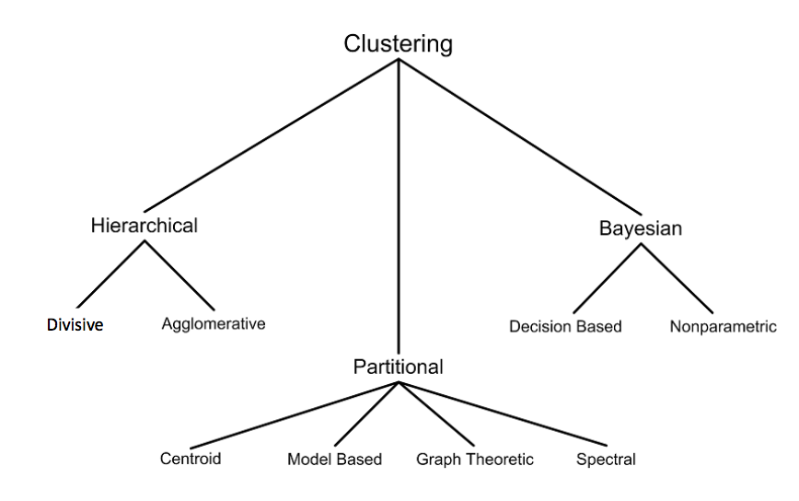
Tons of clustering techniques

Slide 27
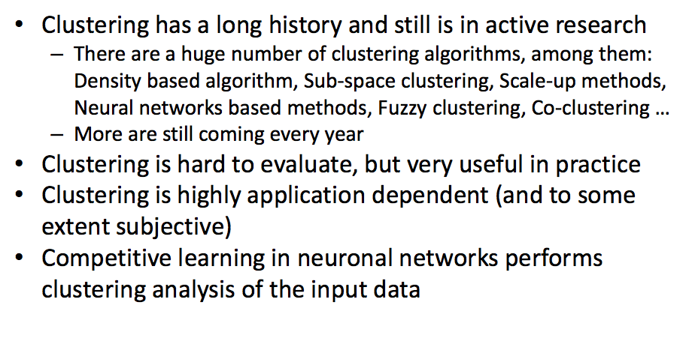
Summary: clustering

Slide 28
Ensemble learning: Fighting the Bias/Variance Tradeoff

Slide 29
Ensemble methods
Combine different models together to
Minimize variance
Bagging
Random Forests
Minimize bias
Functional Gradient Descent
Boosting
Ensemble Selection

Slide 30
Ensemble methods
Combine different models together to
Minimize variance
Bagging
Random Forests
Minimize bias
Functional Gradient Descent
Boosting
Ensemble Selection

Slide 31
Bagging
P(x,y)
S’
Goal: reduce variance
Ideal setting: many training sets S’
Train model using each S’
Average predictions
sampled independently
Variance reduces linearly
Bias unchanged
E_{S}[(h(x|S) - y)²] = E_{S}[(Z-ž)²] + ž²
Z = h(x|S) – y
ž = E_{S}[Z]
Expected Error
Variance
Bias
“Bagging Predictors” [Leo Breiman, 1994]
http://statistics.berkeley.edu/sites/default/files/tech-reports/421.pdf

Slide 32
Bagging
S
S’
Goal: reduce variance
In practice: resample S’ with replacement
Train model using each S’
Average predictions
from S
Variance reduces sub-linearly
(Because S’ are correlated)
Bias often increases slightly
E_{S}[(h(x|S) - y)²] = E_{S}[(Z-ž)²] + ž²
Z = h(x|S) – y
ž = E_{S}[Z]
Expected Error
Variance
Bias
Bagging = Bootstrap Aggregation
“Bagging Predictors” [Leo Breiman, 1994]
http://statistics.berkeley.edu/sites/default/files/tech-reports/421.pdf

Slide 33
Random Forests
Goal: reduce variance
Bagging can only do so much
Resampling training data asymptotes
Random Forests: sample data & features!
Sample S’
Train DT
At each node, sample features (sqrt)
Average predictions
Further de-correlates trees
“Random Forests – Random Features” [Leo Breiman, 1997]
http://oz.berkeley.edu/~breiman/random-forests.pdf

Slide 34
Ensemble methods
Combine different models together to
Minimize variance
Bagging
Random Forests
Minimize bias
Functional Gradient Descent
Boosting
Ensemble Selection

Slide 35
Gradient Boosting
h(x) = h₁(x)
+ h₂(x)
+ … + h_{n}(x)
S’ = {(x,y)}
S’ = {(x,y-h₁(x))}
S’ = {(x,y-h₁(x) - … - h_{n-1}(x))}
…
h₁(x)
h₂(x)
h_{n}(x)

Slide 36
Boosting (AdaBoost)
h(x) = a₁h₁(x)
+ a₂h₂(x)
+ … + a₃h_{n}(x)
S’ = {(x,y,u₁)}
S’ = {(x,y,u₂)}
S’ = {(x,y,u₃))}
…
h₁(x)
h₂(x)
h_{n}(x)
u – weighting on data points
a – weight of linear combination
Stop when validation
performance plateaus
(will discuss later)
https://www.cs.princeton.edu/~schapire/papers/explaining-adaboost.pdf

Slide 37
Ensemble Selection
Training S’
H = {2000 models trained using S’}
Validation V’
S
Maintain ensemble model as combination of H:
h(x) = h₁(x) + h₂(x) + … + h_{n}(x)
+ h_{n+1}(x)
Denote as h_{n+1}
Add model from H that maximizes performance on V’
Repeat
Models are trained on S’
Ensemble built to optimize V’
“Ensemble Selection from Libraries of Models”
Caruana, Niculescu-Mizil, Crew & Ksikes, ICML 2004

Slide 38
Summary
Method | Minimize Bias? | Minimize Variance? | Other Comments
Bagging | Complex model class. (Deep DTs) | Bootstrap aggregation (resampling training data) | Does not work for simple models.
Random Forests | Complex model class. (Deep DTs) | Bootstrap aggregation + bootstrapping features | Only for decision trees.
Gradient Boosting (AdaBoost) | Optimize training performance. | Simple model class. (Shallow DTs) | Determines which model to add at run-time.
Ensemble Selection | Optimize validation performance | Optimize validation performance | Pre-specified dictionary of models learned on training set.

